Slide 1
Egyptian, Babilonian mathematics: procedures, no proofs, no general theorems.
No distinction between exact and approximative calculation.
Classical literature: Neugebauer, The exact sciences in antiquity
van der Waerden, Awakening science
Early Greek mathematics (6th century B.C., Thales’ time)
Convincing by intuitivity
Arithmetic of pebbles (pséphoi, calculi): triangle numbers, quadrat numbers, etc.
Theorem: if you take a triangle number eight times and add one you get a quadrat number
Geometry: general theorems with easy intuitive proof (Thales’ theorem)
Sometimes, an exact proof would need Archimedes’ infinitesimal methods
The verb of proof: deiknymi, literally „to show”

Slide 2
The „anti-empirical, anti-visual” turn (5th century B.C.):
Nothing is accepted as obvious, everything should be proved.
Deductive method appears; the first stoikheia
Geometry becomes the main area of research
The discovery of irrationality (incommensurability)
Pythagorean theorem
Tetragonalisation problems
Hippocrates’ lunulae (little moons)
An interesting section of Euclid’ Elements: the theory of odd and even.
Book IX (Applications of number theory)

Slide 3
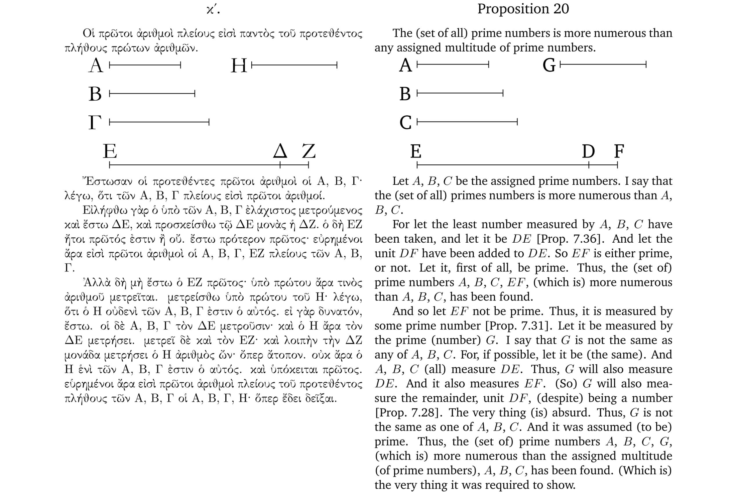

Slide 4
From Prop. 35 on: deep theorems of number theory again.
Szabó: Prop. 21-34. is an older enclosure in the text: a pythagorean mathéma.
„Visualisation”: perfectly irrelevant, not intuitive at all.
(Goes back to manuscripts from the late antiquity.)

Slide 5
Why the turn?
Szabó’s question: How mathematics became a deductive science?
László Kalmár: „The development of mathematical rigor from intuition to axiomatic method” (1942): a rational reconstruction of history
The best maths (creative, beautiful etc.) is the informal, intuitive maths.
Why we need to be deductive? To convince others (the sceptics).
We must reduce our claims to basic propositions that can be accepted by the other.
Szabó: this is the principle of antique dialectics (originated by Zeno of Elea).
The turn presupposes that we believe more to logic (to argumentation) than to our eyes.
Incommensurability needs indirect proof and cannot be proved on an intuitive way. [?]
This is surely true for the proof Aristotle alludes to.

Slide 6
Let us call indirect proof an argument that uses one of the following principles:
{A → B; ¬B} ⇒ ¬A [ModusTollens, MT]
{A → B; A → ¬B} ⇒ ¬A [Consequentia Mirabilis, CM]
Indirect hypothesis: A
It implies something false (MT) or just a contradiction (CM).
Therefore, A is false.
Therefore, ¬A is true.
Why is this way of argumentation valid?
A plausible argument for MT:
A is either true or false. [Principle of Excluded Middle, PEM]
If it is true, then B is true, too. [Modus Ponens, MP.]
But we know that B is false.
And a proposition cannot be true and false at once. [Principle of Contradiction, PC]
Therefore, it cannot be the case.
Therefore A is false.
It seems that both PEM and PC is needed to the validity of indirect proofs.

Slide 7
Milesian cosmogony: explanations to the origin of the world/nature
by experience and analogy
Criticism:
(Parmenides, fr. 7)

Slide 8
Fr. 8, 5-9:
[About „what is”, or the Being] It
Stucture:
(Question = indirect hypothesis)
If it was created, it was created from something that which is not.
But there is nothing which is not. (*)
Therefore, it was not created.
All the arguments for the „signs of the Being” have the same structure.
They always use something like the premiss (*).
Why should we accept it?

Slide 9
Fr. 2
„it is and it cannot not –be”
Fr. 7: almost the same
But what does it mean?

Slide 10
Four „senses” of the verb of being:
Existence predicate
Veridic (is the case that …)
Copula
Sign of identity
Supplement for noun predicates
All the four are relevan to the understanding of Parmenides.
Each one generates an interpretation and even formalisation of the saying.
The expression is elliptic under each interpretation.
Neglect the modal expression (‚cannot’).
1.
Interpretation:
Everything (every thing) exists and there are no non-existents.
∃xE(x)∧¬∃x¬E(x)
A plausible meaning postulate for the existence predicate.

