Slide 1
Tarski’s T-scheme:
S is true iff s.
To be substituted with a name of the same sentence
To be substituted with a sentence
Tarski: A necessary condition for the adequacy of a truth definition that every instance of the T-scheme (every T-equivalence) follow from it.
Special case: every sentence named by its quotation name.
‘…’ is true if and only if …. (‘Snow is white’ is true iff snow is white.)
Two halves:
If ‘…’ is true, then …. (Disquotation)
If …, then ‘…’ is true. (QD)

Slide 2
The Liar:
Be λ another name of the sentence ‘This proposition is not true’.
Be f the proposition that λ expresses in the case when ‘this popositon’ denotes the proposition expressed by λ itself.
T-equivalence:
‘This proposition is not true’ is true iff this proposition is not true.
is true iff f is not true.
But a sentence is true if and only if the proposition expressed by it is true. (*)
Therefore, λ is true iff f is true.
f is true iff it is not true.
Should we accept (*)?
It says that … is true iff it is the case what it says.
The Truth-teller:
Be τ the sentence ‘This proposition is true’ and t the prop expressed by it in the relevant case.
t can be assumed either true or false as you like (independently from any other fact).
A proposition is up for grabs if its truth-value is arbitrary.

Slide 3
Liar cycles:
Every sentence says that the (proposition expressed by) the next one is true and the last sentence says that the first one is false.
Contingent liars/cycles:
They are paradoxical if some other proposition (a ‘matter of fact’ holds).
Example: the Cretan in the case when no other Cretan said a word.
Löb’s paradox:
If (1) is true, then I am a wizard from the Mars.
This conditional is (provably) true because we can derive its consequent from the antecendent.
Let us assume the antecendent:
(2) (1) is true
If this holds, then (by disquotation) it is the case what (1) says , namely
(3) If (1) is true, then I am a wizard from the Mars.
From (2) and (3) follows (by MP) that
(4) I am a wizard from the Mars.
From this deduction follows (by conditionalization) that
(1) If (1) is true, then I am a wizard from the Mars.
Therefore, (by QD) (1) is true.
Therefore , (by MP) I am a wizard from the Mars.

Slide 4
Gupta’s puzzle:
(P1) Budapest is the capital of Hungary.
(P2) At most one of R’s claims is true.
(R1) Bucharest is the capital of Hungary,
(R2) All of P’s claims are true.
(R3) At least one of P’s claims is false.
The puzzle is that it is not a paradox. But in Kripke’s account, P2, R2 and R3 have no level, and no truth-value at the minimal fixed point.
But they have an intrinsic truth-value.
Strenghtened Liar: the (apparently) no-gap version is not very clear.

Slide 5
Russelian propositions:
A proposition claims that a relation holds resp. doesn’t hold between some objects (positive resp. negative propositions).
In case of an n-ary relation it could be represented by an n+3-tuple
<Prop, R, i1, i2, …. in, i> where i is is a sign (1 resp. 0).
Or on some other way.
Anyway, the signature will be this:
[R, i1, i2, … in] for positive and [R, i1, i2, … in] for negative propositions.
Austinian propositions:
A proposition p identifies a situation (About(p)) and claims that it is of a certain type (Type(p)). Both will be set-theoretic objects again. (Idea: to take context dependency seriously.)

Slide 6
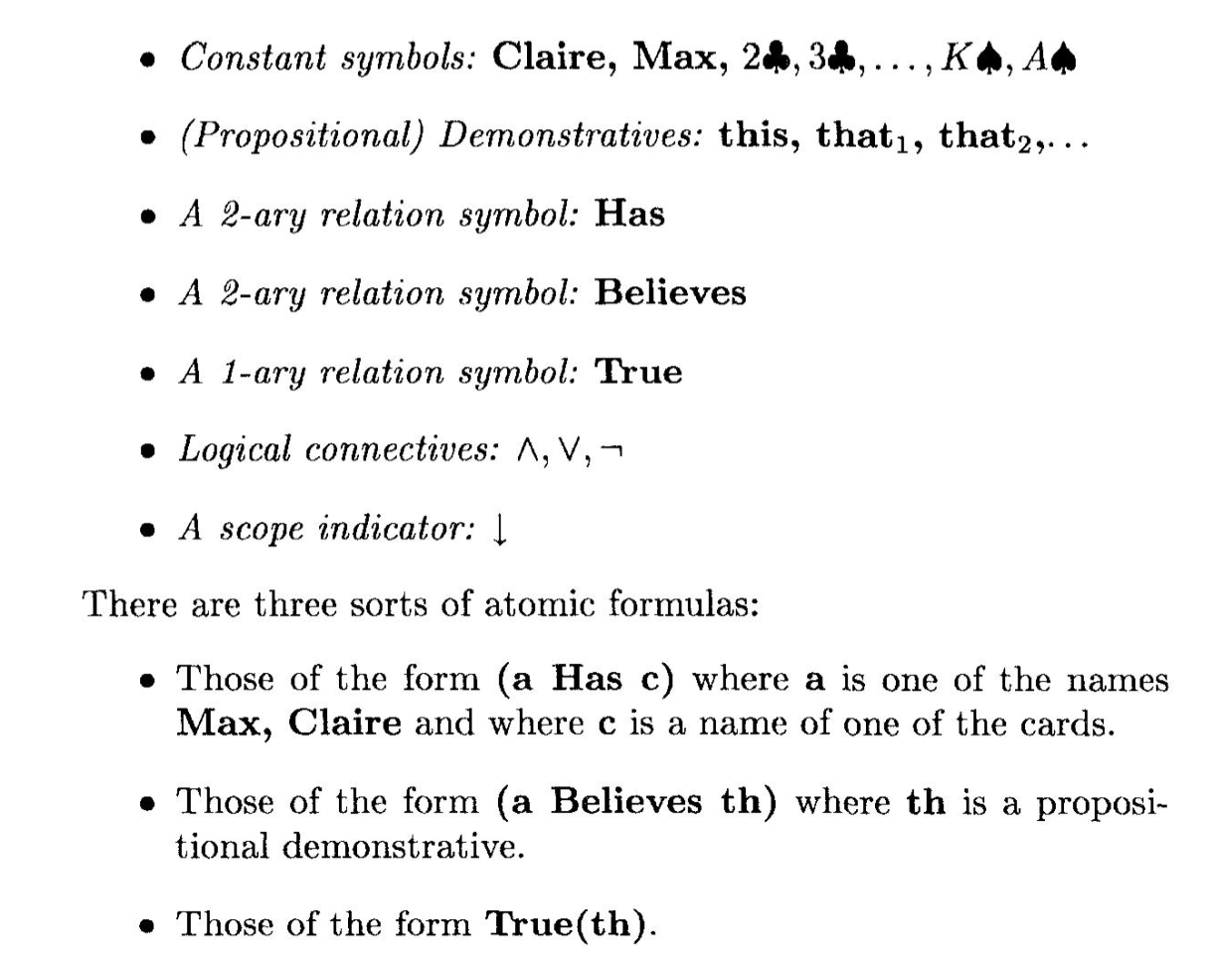
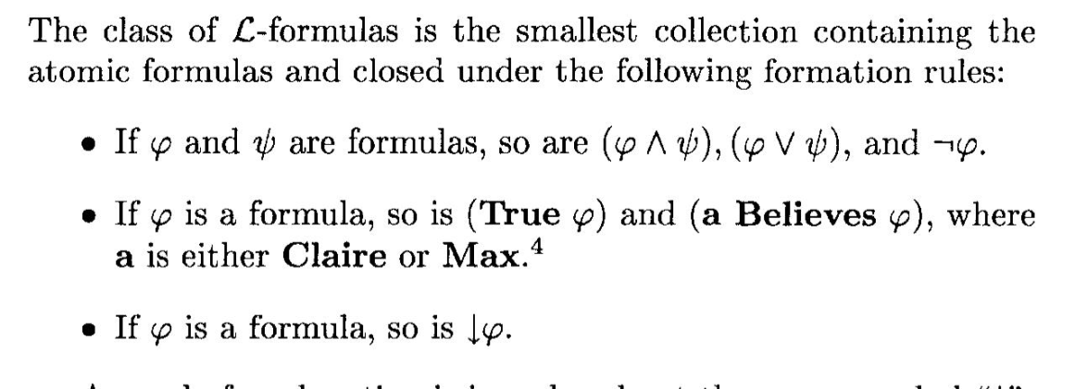
The language L:

Slide 7
